Slide 1
Foundations of Machine Learning
Module 6: Neural Network
Part D: Deep Neural Network
Sudeshna Sarkar
IIT Kharagpur

Slide 2
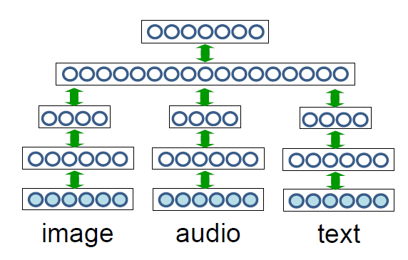
Deep Learning
Breakthrough results in
Image classification
Speech Recognition
Machine Translation
Multi-modal learning

Slide 3
Deep Neural Network
Problem: training networks with many hidden layers doesn’t work very well
Local minima, very slow training if initialize with zero weights.
Diffusion of gradient.

Slide 4
Hierarchical Representation
Hierarchical Representation help represent complex functions.
NLP: character ->word -> Chunk -> Clause -> Sentence
Image: pixel > edge -> texton -> motif -> part -> object
Deep Learning: learning a hierarchy of internal representations
Learned internal representation at the hidden layers (trainable feature extractor)
Feature learning
Input
Trainable Feature Extractor
…
Trainable Feature Extractor
Trainable Classifier
Output

Slide 5
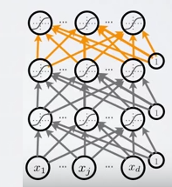
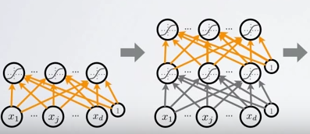
Unsupervised Pre-training
We will use greedy, layer wise pre-training
Train one layer at a time
Fix the parameters of previous hidden layers
Previous layers viewed as feature extraction
find hidden unit features that are more common in training input than in random inputs

Slide 6
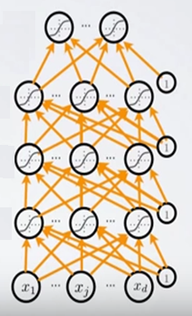
Tuning the Classifier
After pre-training of the layers
Add output layer
Train the whole network using supervised learning (Back propagation)

Slide 7
Deep neural network
Feed forward NN
Stacked Autoencoders (multilayer neural net with target output = input)
Stacked restricted Boltzmann machine
Convolutional Neural Network

Slide 8
A Deep Architecture: Multi-Layer Perceptron
Output Layer
Here predicting a supervised target
Hidden layers
These learn more
abstract representations
as you head up
Input layer
Raw sensory inputs
y
…
h3
h2
…
h1
…
x
…

Slide 9
A Neural Network
Training : Back Propagation of Error
Calculate total error at the top
Calculate contributions to error at each step going backwards
The weights are modified as the error is propagated
INPUT LAYER HIDDEN LAYER OUTPUT LAYER

Slide 10
Training Deep Networks
Difficulties of supervised training of deep networks
Early layers of MLP do not get trained well
Diffusion of Gradient – error attenuates as it propagates to earlier layers
Leads to very slow training
the error to earlier layers drops quickly as the top layers "mostly" solve the task
Often not enough labeled data available while there may be lots of unlabeled data
Deep networks tend to have more local minima problems than shallow networks during supervised training

Slide 11
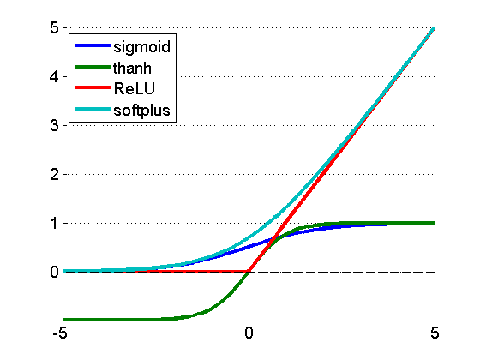
Training of neural networks
Forward Propagation :
Sum inputs, produce activation
feed-forward
Activation Functions examples
INPUT LAYER HIDDEN LAYER OUTPUT LAYER

Slide 12
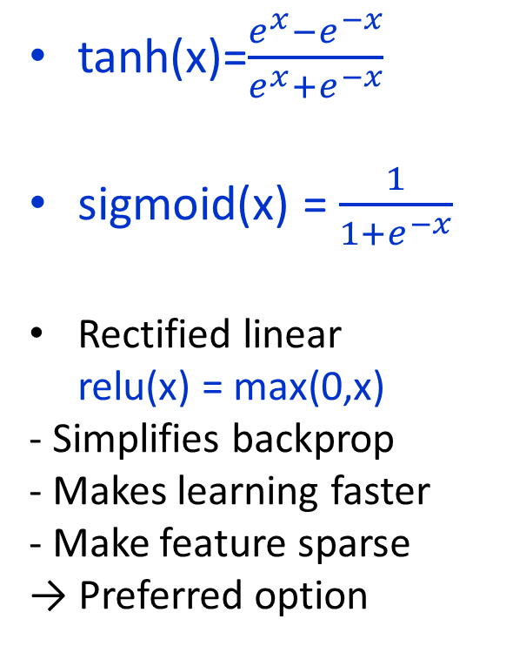
Activation Functions
Non-linearity
tanh(x)=$\frac{e^{x}−e^{−x}}{e^{x}+e^{−x}}$
sigmoid(x) = $\frac{1}{1+e^{−x}}$
Rectified linear
relu(x) = max(0,x) - Simplifies backprop - Makes learning faster - Make feature sparse
→ Preferred option
Notes:
하이퍼볼릭 탄젠트

Slide 13
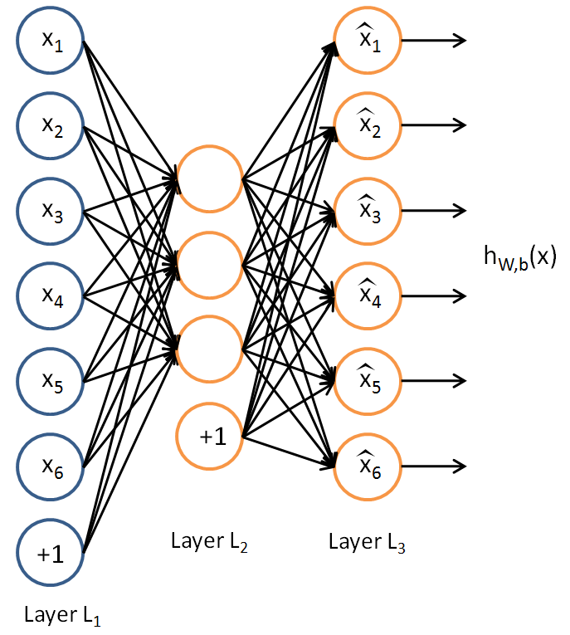
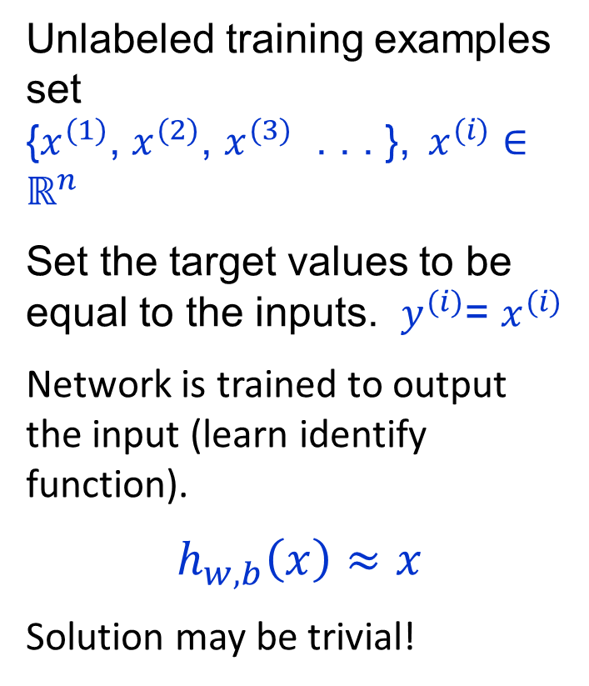
Autoencoder
Unlabeled training examples set
{$x^{(1)}$, $x^{(2)}$, $x^{(3)}$ . . . }, $x^{(i)}∈ℝ^{n}$
Set the target values to be equal to the inputs. $y^{(i)}$= $x^{(i)}$
Network is trained to output the input (learn identify function).
$$h_{w,b}\left(x\right)≈x$$
Solution may be trivial!
a₁
a₂
a₃

Slide 14

Autoencoders and sparsity
Place constraints on the network, like limiting the number of hidden units, to discover interesting structure about the data.
Impose sparsity constraint.
a neuron is “active” if its output value is close to 1
It is “inactive” if its output value is close to 0.
constrain the neurons to be inactive most of the time.

Slide 15
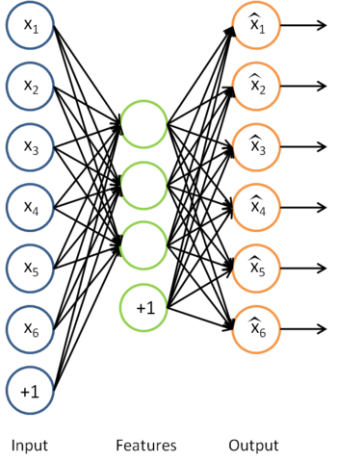
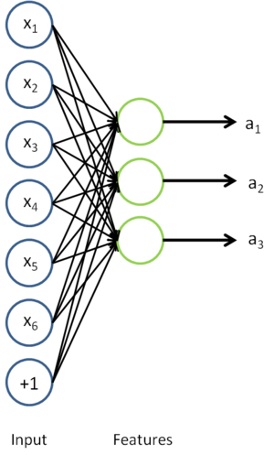
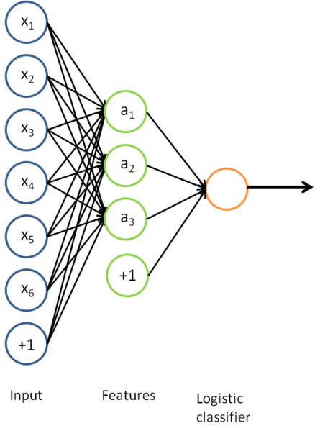
Auto-Encoders
Notes:
Mention Zipser auotencoder with reverse engineering, then Cottrell compression where unable to reverse engineer

Slide 16
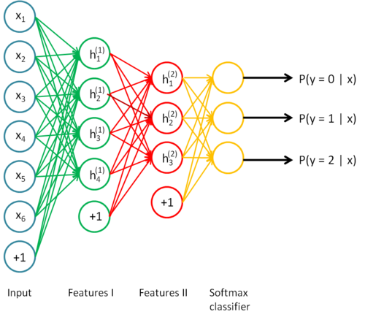
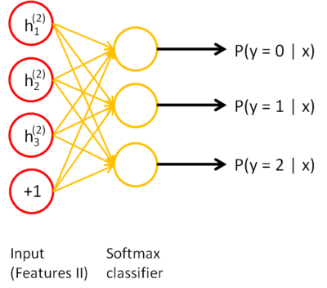
Stacked Auto-Encoders
Do supervised training on the last layer using final features
Then do supervised training on the entire network to fine- tune all weights
Notes:
Shows softmax, but could use BP or any other variation

Slide 17
Convolutional Neural netwoks
A CNN consists of a number of convolutional and subsampling layers.
Input to a convolutional layer is a m x m x r image where m x m is the height and width of the image and r is the number of channels, e.g. an RGB image has r=3
Convolutional layer will have k filters (or kernels)
size n x n x q
n is smaller than the dimension of the image and,
q can either be the same as the number of channels r or smaller and may vary for each kernel

Slide 18
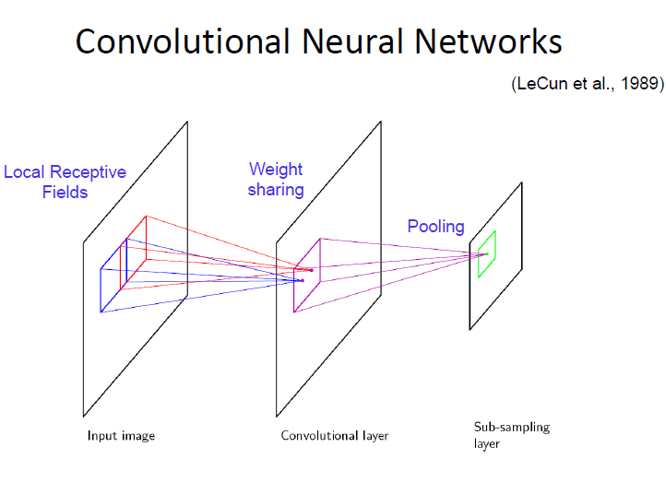
Convolutional Neural netwoks
Convolutional layers consist of a rectangular grid of neurons
Each neuron takes inputs from a rectangular section of the previous layer
the weights for this rectangular section are the same for each neuron in the convolutional layer.

Slide 19
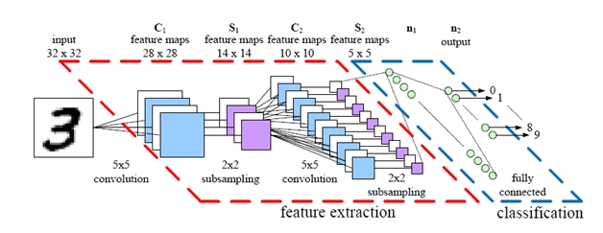
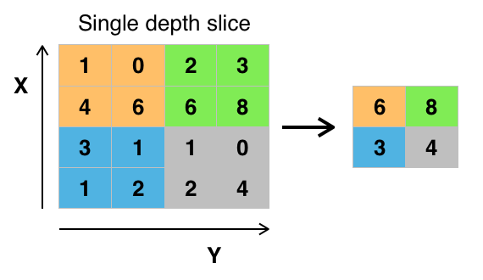
Pooling: Using features obtained after Convolution for Classification
The pooling layer takes small rectangular blocks from the convolutional layer and subsamples it to produce a single output from that block : max, average, etc.

Slide 20
CNN properties
CNN takes advantage of the sub-structure of the input
Achieved with local connections and tied weights followed by some form of pooling which results in translation invariant features.
CNN are easier to train and have many fewer parameters than fully connected networks with the same number of hidden units.

Slide 21
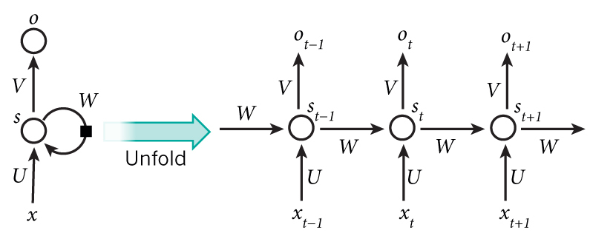
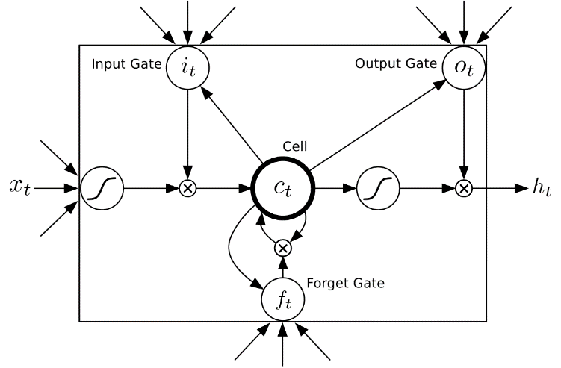
Recurrent Neural Network (RNN)

Slide 22
Thank You

